Slide 1
Helpful logging with Java
Thomas Aglassinger
http://www.roskakori.at
v1.1.1

Slide 2


About me
Thomas Aglassinger
Software developer
  Industry experience since 2001 in various areas (health care, banking, e-commerce, customer relationship management)
  Casual open source developer
  2 x MSc
Links
  http://www.roskakori.at
  @TAglassinger
  https://github.com/roskakori

Slide 3

Motivation
Logging is part of non trivial software development
During debugging and tracking down support issues,
developers (and others) spend quite some time looking at log files
Technical aspects of logging are well described, how to use logging in a helpful way - not so much
This talk intends to share experiences
and things that “worked for me”
Somewhat backed up by literature
Source: https://commons.wikimedia.org/wiki/File:Light_bulb_(yellow)_icon.svg

Slide 4
Agenda
Logging with Java – the basics
Logging at different levels: INFO, ERROR, FATAL, WARNING, DEBUG
Various considerations: performance, security, scaling, operations

Slide 5
Logging – the basics

Slide 6
Why logging?
Analysis: even after the fact, complements debugging with breakpoints
Monitoring: Can provide triggers for monitoring systems
→ react on certain log messages
Support: collects information even when run on a different computer by another users
Application metrics: answer questions like “How often did a certain error occur in the past 3 months?”

Slide 7
Logging frameworks and libraries
Plenty of options
  Log4j: grand daddy of logging
  Java.util.logging: part of standard library
  Slf4j (Simple logging facade for Java) allows to plug in logging framework during runtime
  ...and many others
Application can create multiple loggers, e.g. per class
Loggers can log messages at different levels
Messages can be...
  formatted flexibly: timestamp, level, message, logger name, thread, ...
  sent to various outputs: console, log file, data base, network, ...
  filtered as needed: only certain loggers or levels

Slide 8
Logging example
import java.util.logging.Logger;
public class Example {
private static final Logger LOG = Logger.getLogger(Example.class.getName());
public void greet() {
LOG.info("Hello world!");
LOG.fine(() -> String.format("Greetings from %s!", Example.class.getName()));
}
public static void main(String[] args) {
Example example = new Example();
example.greet();
}
}

Slide 9
Logging example
Create a new logger
import java.util.logging.Logger;
public class Example {
private static final Logger LOG = Logger.getLogger(Example.class.getName());
public void greet() {
LOG.info("Hello world!");
LOG.fine(() -> String.format("Greetings from %s!", Example.class.getName()));
}
public static void main(String[] args) {
Example example = new Example();
example.greet();
}
}
Will be logged
Message includes
variable
Lamda to resolve String.format()
only if log level is sufficient
Default for java.util.logging:
Log level INFO or higher
to console
Will be suppressed

Slide 10
Logging levels
Something along the line of DEBUG, INFO, WARN, ERROR, FATAL (see next slide for mapping)
Corresponding methods to log a message:
debug(), info(), warn(), error(), fatal()
Messages below a certain level can be suppressed using e.g.
someLogger.setLevel() or configuration files
Use getLogger(Some.class.getName()) to use a class as name
Packages and sub-packages can be controlled hierarchically

Slide 11
Logging levels: mapping
slf4j | Log4j | java.util.logging
FATAL | FATAL | n/a
ERROR | ERROR | SEVERE
WARN | WARN | WARNING
INFO | INFO | INFO
DEBUG, TRACE | DEBUG, TRACE, ALL | FINE, FINER, FINEST

Slide 12
Logging the stack trace 1/2
try {
String[] data = new String[]{};
System.out.println(data[17]);
} catch (ArrayIndexOutOfBoundsException error) {
LOG.log(Level.SEVERE, "cannot print data", error);
}
SEVERE: cannot print data
java.lang.ArrayIndexOutOfBoundsException: Index 17 out of bounds for length 0
at Snipplets.logWithStackTrace(Snipplets.java:32)
at Snipplets.main(Snipplets.java:42)

Slide 13
Logging the stack trace 2/2
What about exceptions not caught by any code?
  Depends on Java implementation
  Typically: print stack trace to stderr and terminate thread / application
Solution:
  Use Thread.setDefaultUncaughtExceptionHandler()
  In handler, log exception
See also: Uncaught Java Thread Exceptions

Slide 14
Tools to collect and search logs
logstash and kibana (based on elasticsearch)
graylog
nagios core with check_logfiles plugin
Available as basic open source product and fully featured commercial product

Slide 15
INFO logging

Slide 16
Motivation for INFO messages
Quickly see what application is doing right now (or was doing at a certain point in time)
Trace back what caused a certain error
High level
If possible using business terms (process, document, file, customer record, ...)
Small amount of messages to avoid information overflow and excessive impact on log storage

Slide 17
When to use INFO
With high level components: business relevant actions and decisions that influence the result
  Business process start / end
  Input received / output sent
  Major branches in process logic
With low level components: essential operations
  Incoming requests
  Start / end of transactions (database, files, network, …)
  Connection to other services or resources (database)
  Important state changes ( configuration changes, log in, session context, …)
  Start / end of complex calculation, important results
  Progress information (download, calculation, ...)

Slide 18
Logging before / after the fact
Before: use present tense participle (“-ing form”),
for example:
reading customer data from “customers.csv”
After: use past tense, for example:
read 1234 customer records from “customers.csv”

Slide 19
Perspective of log messages
Word log messages from the perspective of the application
I = the application
you = the reader of the log
In line with usability engineering (i.e. status messages, progress bars, error dialogs)

Slide 20
Grammar of log messages
When the application is about to do something: present progressive: for example:
  reading customer data from “customers.csv”
When the application finished doing something: past tense, for example:
  processed 1234 customer records from “customers.csv”
  read 1234 customer records from “customers.csv” [to read = irregular verb]
When the application expects the log reader to do something: imperative (German: Befehlsform), for example:
  check proxy settings
  see section 12.3.4 of the user guide for more information
  visit https://example.com to download the update

Slide 21
Example: no logging
try (Stream<String> lines = Files.lines(customerPath)) {
lines.forEach(this::processCustomer);
};

Slide 22
Example: basic logging
LOG.info(String.format("processing customers from \"%s\"", customerPath));
AtomicInteger customerCounter = new AtomicInteger(0);
try (Stream<String> lines = Files.lines(customerPath)) {
lines.forEach(line -> {
processCustomer(line);
customerCounter.getAndIncrement();
});
};
LOG.info(String.format("processed %d customers", customerCounter.get()));
INFO: processing customers from "customers.txt"
INFO: processed 73 customers

Slide 23
Summary (so far)
Info-log only essential actions and decisions
When possible use business terms
Mind the grammar for clear wording
  Present progressive tense
  Past tense
I = software, you = log reader
  Imperative to address reader

Slide 24
ERROR logging

Slide 25
Detecting errors
Detect yourself with „if“:
Detect error thrown by called function using „catch“:
if (actualValue != expectedValue) {
// handle error
}
try {
doSomething();
} catch (SomeError error) {
// handle error
}

Slide 26
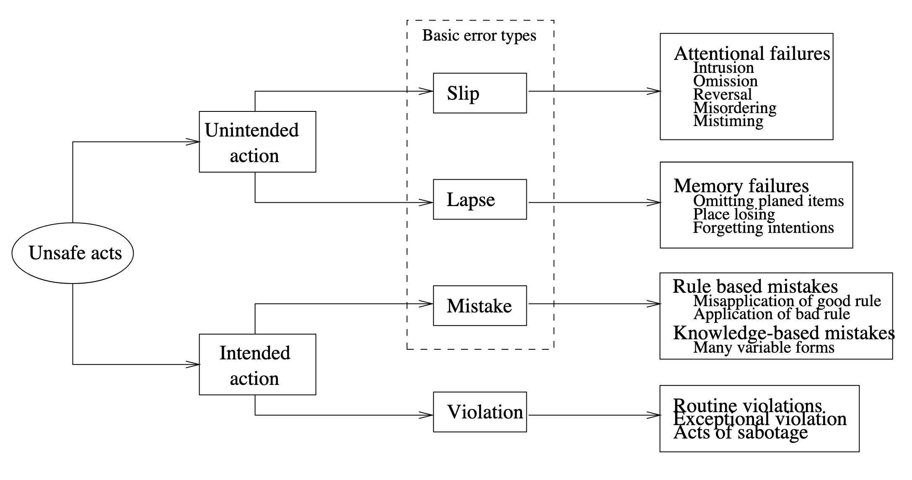
Human error as unsafe acts
Source: J. Reason (1990), „Human Error“, p. 207

Slide 27
Examples for unsafe acts
Slip: person does something they did not intent to and would know better, e.g. type “their” instead of “there”
Lapse: person forgets to do something they intended to do, e.g. exit application without saving
Mistakes: person "intentionally"carries out a sequence of actions that - maybe even possible and correct for the application - do not give them what they want, e.g. try to open text document in spreadsheet application
Violations: e.g. workaround, sabotage

Slide 28
Solving errors
Provide information for the log reader to reflect about the situation that lead to an error
State: spell out what the data where provided / processed
→ particularly helpful to detect slips and lapses
Context: spell out what the software actually was doing
→ particularly helpful to detect lapses and mistakes

Slide 29
Describing the error context
Message should describe the context in which the error was detected
Description should be self contained
  Object that caused error, e.g. file, customer number, session number
  Action that was attempted to be performed, e.g. reading, writing, calculation, creating, connecting, …
  Parameters or values that were attempted to be processed
Previous (info) log messages should only help to find out how this context was reached

Slide 30
Template for error messages
For now just log.
Discussion on log vs throw: soon
Detect yourself with „if“:
Detect error thrown by called function using „catch“:
if (actualValue != expectedValue) {
LOG.severe(() -> String.format("some value is %s but must be %s",
actualValue, expectedValue));
}
try {
doSomething();
} catch (SomeError error) {
// Log exception message without stack trace.
LOG.severe(String.format("cannot do something: %s", error));
}

Slide 31
Variants for „detect yourself“
Value cannot be processed: „some value is %s but must…“
  … be between 0 and 100
  … be one of: red, green, blue
  … match format YYYY-MM-DD
Value not found in a large set of possible values:
  „cannot find customer number 1234“
  „cannot find customer number 1234; possible similar customer numbers: 1243, 1324“
Missing required value:
  „date of birth must be specified“
  „data of birth must be specified for age validation“ (explains why value is required)
Unterminated context of recursive descent parsers:
  „string started in line 17, column 23 must be terminated with quote“
  avoid useless “unexpected end of file”

Slide 32
Log or throw error?
Log error: Few parts of the code will log errors
  main() before System.exit(1)
  self contained request handlers / dispatchers that simply continue with next independent request
  form validation → show error and remain in form
Raising error:
  guidelines for wording error message apply
  can’t do anything about it anyway, just report it to the caller

Slide 33
Log and throw error: anti pattern
Spams log with redundant and thus confusing error messages
// BAD EXAMPLE, don't use this template
try (Stream<String> lines = Files.lines(customerPath)) {
lines.forEach(this::processCustomer);
} catch (IOException error) {
LOG.log(Level.SEVERE,
() -> String.format(
"cannot process customers in \"%s\"", customerPath),
error);
throw error;
}

Slide 34
Use exception cause instead
Adds context information in new exception
Preserves existing information in exception with cause
public void processCustomers(Path customerPath) {
try (Stream<String> lines = Files.lines(customerPath)) {
lines.forEach(this::processCustomer);
} catch (IOException error) {
String message = String.format(
"cannot process customers in \"%s\"", customerPath);
throw new SomeError(message, error);
}
}

Slide 35
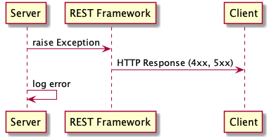
Log and throw error: valid scenario
Frameworks for REST API that convert exception into HTTP response:
  Server throws exception
  REST Framework converts exception
  into 4xx or 5xx HTTP response and
  thus reports error to the client
  Unless server also logs exception,
  information about error would only
  be available to client

Slide 36
Further reading on error handling
Lösungsorientierte Fehlerbehandlung (with Python)
How to write good error messages (with many examples)

Slide 37
FATAL messages

Slide 38
Fatal errors
When application has to exit in unclean manner
  Resource leaks
  Data loss
Typical before involuntary server shutdown
Inappropriate for:
  Unprocessable single request / command / user input
  Errors during program startup, e.g. missing command line option or broken syntax in configuration file

Slide 39
Wording fatal messages
Messages worded similar to ERROR
Example:
FATAL: cannot reconnect to database some.db: <some database error>
INFO: shutting down server

Slide 40
WARNING messages

Slide 41
Warnings hint at design issues
INFO is „good“
ERROS is „bad“
WARNING is …?

Slide 42

Warnings hint at design issues
INFO is „good“
ERROS is „bad“
WARNING is …?
Warnings delegate the decision if something is good or bad from the software designer to the user / log reader

Slide 43

But still...
Warnings can be useful under certain circumstances
In general: situations where an error can be fixed by the application
  In a deterministic way
  With a high probability it is what the user wants to do

Slide 44
Wording warnings
Mix of error and info should reflect in the wording
Error part: describes what happened and was expected
Info part: describes what is being done / has been done to improve the situation

Slide 45
Transient errors
External errors that might be going away after a while because the cause went away
Might be able to solve with retries
Example:
WARNING:example: Cannot connect to database some.db, trying to reconnect (attempt 2 of 5)

Slide 46
Reduced quality of service
In environment with multiple redundant components that can perform the same task
Example:
  replicas of search platform
  stateless micro services
request

Slide 47
Reduced quality of service
In environment with multiple redundant components that can perform the same task
Example:
  replicas of search platform
  stateless micro services
Example:
request
WARNING: Cannot connect to search server abcd17. Temporarily removing server from pool and delegating request to server abcd18

Slide 48
Using default values
Only appropriate for non business critical information
  Configuration files
  Layout of graphical components
Example:
For single values (e.g. command line arguments): instead of warning make arguments optional and use documented default values (e.g. available with --help)
WARNING: Cannot read configuration from „~/.somerc“,
using default configuration in „/opt/some/defaultrc“

Slide 49
DEBUG messages

Slide 50
Debug messages
Target audience
  debug: developers familiar with the code
  any other log level: devops, operations, users, …
Wording
  if possible similar to INFO
  otherwise: whatever rocks your boat
    names of classes, methods, variables
    dumps of XML, JSON, request headers
    escaped string, hexadecimal garble
    ...

Slide 51

Amount of information
On other log levels, numbers of messages was as small as possible
Debug messages can be many because the application normally does not run with log level set to DEBUG
Source: https://knowyourmeme.com/memes/zerg-rush

Slide 52
Enabling debug logging
Only temporarily while tracing an issue
Otherwise: too much strain on storage and collection of logs
Enable only for loggers that are expected to contain relevant information
Consider adding a mechanic to your application that allows to change log levels during runtime

Slide 53
Various topics

Slide 54
Performance 1/2
Use log patterns instead of resolved or formatted strings
// BAD: Build string before logging even nothing might be logged.
LOG.info(name + " has a size of " + sizeInCm + "cm");
// BAD: Always resolve String.format().
LOG.info(String.format("%s has a size of %dcm", name, sizeInCm));
// GOOD: Log using supplier (or pattern with Log4j).
LOG.info(() -> String.format("%s has a size of %dcm", name, sizeInCm));
LOG.info("{} has a size of {}cm", name, sizeInCm);

Slide 55
Performance 2/2
Log expensive to obtain information only if logging level is appropriate
// BAD: with slf4j - always compute number even if might not be logged
LOG.debug("processing {} foos", someComputedNumber());
// GOOD: with slf4j - conditional logging of computed information
if (LOG.isDebugEnabled()) {
LOG.debug("processing {} foos", someComputedNumber());
}

Slide 56
Scaling considerations
Thanks, https://mgit.at/!
Log asynchronously to not slow down applications
Challenge: log messages from multiple (possibly thousands of) sources
are collected in a single log platform
  Use transaction / source ID in log message to quickly find related log entries
  Granularity of timestamp: logging frameworks often support nanoseconds but logging platforms might only support milliseconds (limitation of elasticsearch)
  Time on all logging system should be synchronized
  Don’t log warnings for reduced quality of service → pointless because something is always broken
Consolidate log messages from multiple sources at one place
  Kafka and Zookeeper scale well but are comparably difficult to configure and maintain
  Simpler solutions might already suffice, e.g. copy cronjob, S3 and Airflow
Be aware that some logging platforms sort by time received instead of time logged (e.g. graylog)
Further reading: „30 best practices for logging at scale“

Slide 57
Security: what not to log
Sensitive business data
  Passwords
  Credit card numbers
  Session identifiers
  Account numbers
Personally identifiable information
  Social security numbers (mostly USA problem though)
  Birth dates
  Full names
  Email addresses
  Driver’s license numbers
Source: Get Started Quickly With Python Logging
Discussion: IP addresses? GDPR?

Slide 58
Operations
Logging to text file
  Messy regular expressions to split log line into timestamp, level, message etc
  Possible injections issues with line breaks
Logging to structured format (e.g. JSON)
  Log entry is already separated into timestamp, level, message etc
  Messages can have line breaks

Slide 59
Conclusion

Slide 60
Summary
INFO:
  doing vs done
  Focus on business logic
  Keep amount of messages low
ERROR:
  “cannot do something: something must be something else“
  Log vs throw, avoid log and throw
FATAL: like error but only if the application cannot recover
WARNING
  Might hint at design issues
  Few valid situations
  Combines error and info message
DEBUG
  For developers
  Log whatever is necessary

Slide 61
Questions and answers
Thomas Aglassinger
http://www.roskakori.at
@TAglassinger

